Slide 1

Near Duplicate Document Detection Review 2
An Efficient Algorithmic Engine for Identifying Similar & Modified Text Documents
M. Aravindhar Reddy · Ganapuram Veeravardhan · K. Manikanta Reddy · Irfan Faraj

Slide 2

Problem Statement
Massive Data Scale
Limitations of Basic Search
Performance Bottleneck
Large online collections like Wikipedia or web pages contain millions of documents with heavy repetition.
Comparing every document against every other document line-by-line takes too long to run at scale.
Standard search tools look for exact matches and fail when text is lightly edited, reworded, or contains typos.

Slide 3

Project Objectives
⚡ Fast Detection
🔧 Pure Algorithmic Logic
Build a custom, high-speed system to find, group, and score document similarity.
Implement custom algorithms from scratch without relying on external third-party libraries.
📐 Scalable Filtering
Rapidly isolate potential duplicate candidates while skipping completely unrelated files.

Slide 4




Existing vs. Proposed System
Existing System
Proposed Multi-Stage Pipeline
Uses word-by-word or character-by-character comparisons across entire datasets, making it extremely slow and unscalable.
Stage 1 — Filter
Fast digital fingerprints eliminate non-matches instantly.
Brute-force comparison grows quadratically — impractical at any meaningful scale.
Stage 2 — Index
Locates long matching phrases across candidate files.
Stage 3 — Score
Calculates precise edit-based similarity percentages only for likely duplicates.

Slide 5

Architecture & Data Pipeline
Input Layer
Fingerprinting
Indexing Engine
Comparison Engine
Each stage of the pipeline progressively narrows the candidate pool — ensuring deep analysis is only performed where it matters most, maximizing both speed and accuracy.

Slide 6


MODULE 1 — QUICK SCREENING
Fingerprinting
Algorithm: Rabin-Karp Rolling Hash
Splits text into short sliding windows and converts them into unique numerical keys. As the window slides character by character, the hash updates in constant time — no full recomputation needed.
Role in Pipeline: Acts as a super-fast initial scanner that discards totally unrelated documents before any deep analysis begins.
Hash collisions are rare by design — only genuine candidate pairs advance to the next stage.

Slide 7
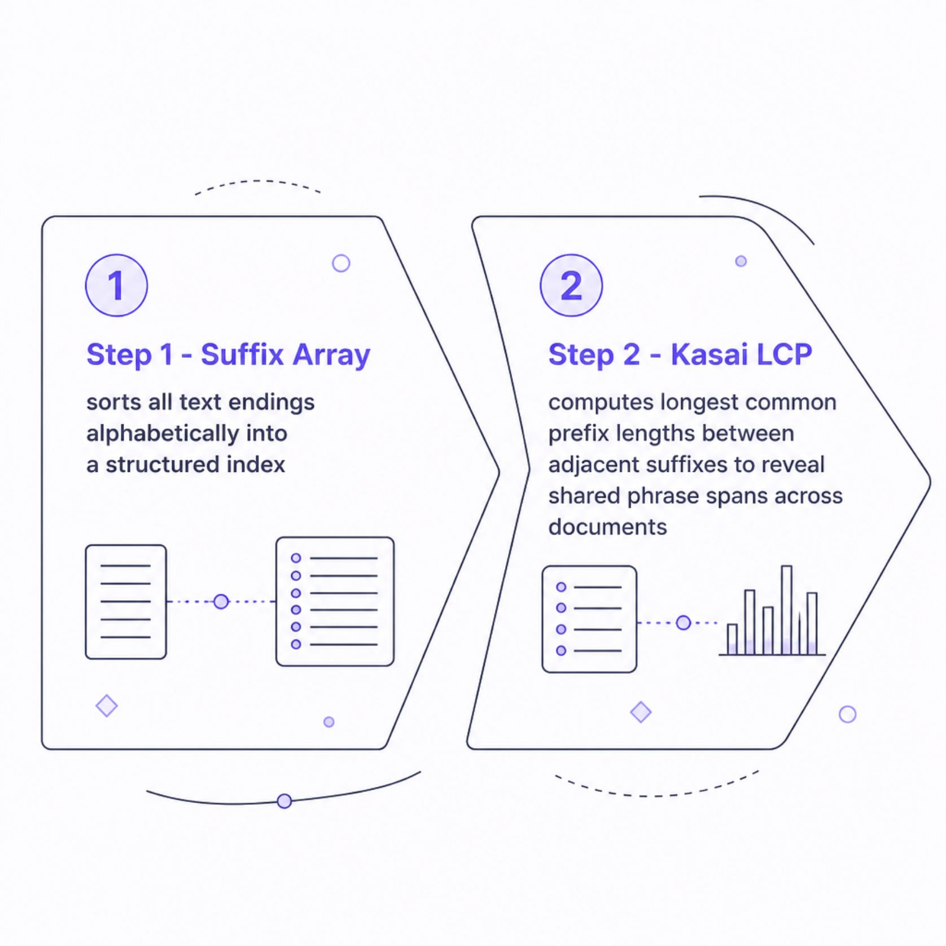
MODULE 2 — SHARED PATTERN INDEXING
Suffix Array & Kasai LCP
All text suffixes are sorted into an alphabetically ordered index. The Kasai algorithm then computes the Longest Common Prefix (LCP) between adjacent entries in linear time, revealing exactly where shared phrases begin and how long they extend.
Role in Pipeline: Instantly pinpoints identical sentences or paragraphs scattered across different files — without scanning every character pair.

Slide 8
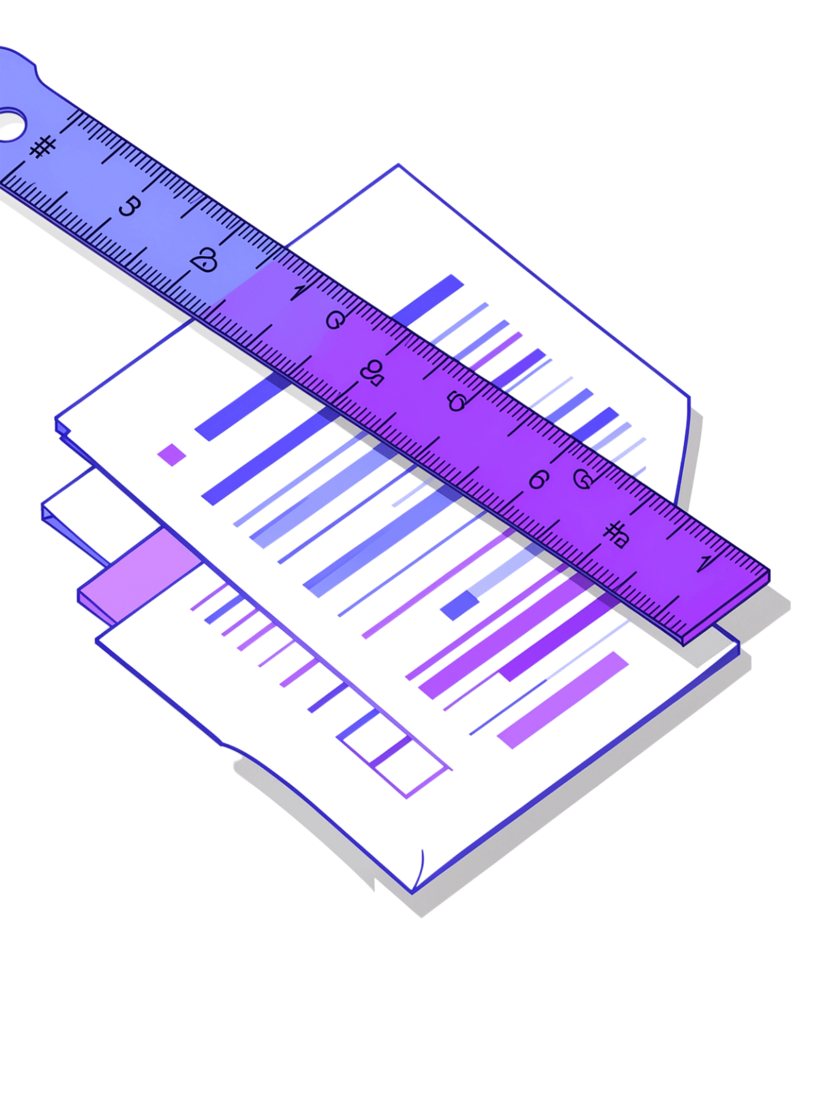

MODULE 3 — EXACT SIMILARITY SCORING
Levenshtein Edit Distance
Algorithm: Levenshtein Edit Distance
Insertions
Runs dynamic programming to count the exact number of insertions, deletions, and substitutions required to transform one candidate text into another.
The result is normalized into a final similarity percentage — giving a precise, interpretable score even when documents have been reworded or lightly modified.
Characters added to one document
Deletions
Characters removed from one document
Substitutions
Characters swapped between documents
Only applied to candidate pairs that passed Stages 1 & 2 — keeping computation efficient.

Slide 9

Thank You
Near Duplicate Document Detection Framework
M. Aravindhar Reddy · Ganapuram Veeravardhan · K. Manikanta Reddy · Irfan Faraj

